Slide 1
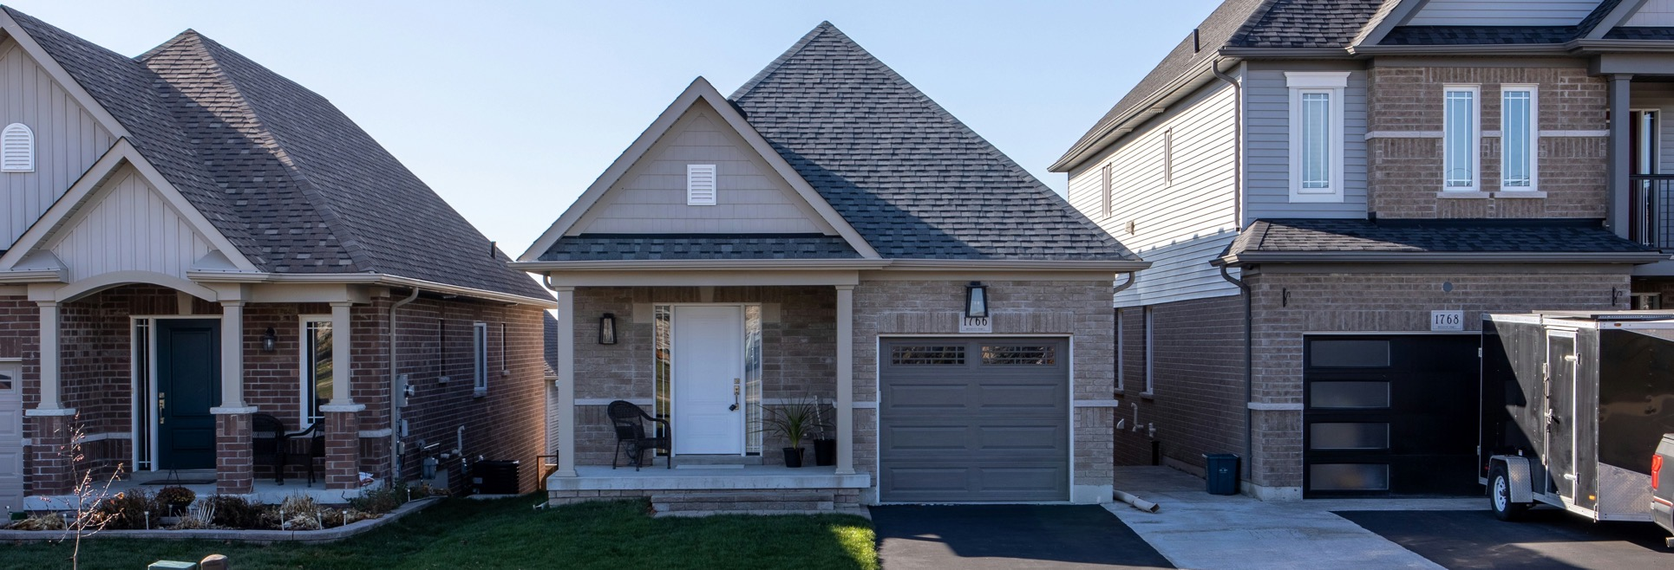
February 25th, 2026 | 1 PM EST
State of the Home Improvement Industry Q1 2026: Trends, Insights, and What’s Ahead

Slide 2
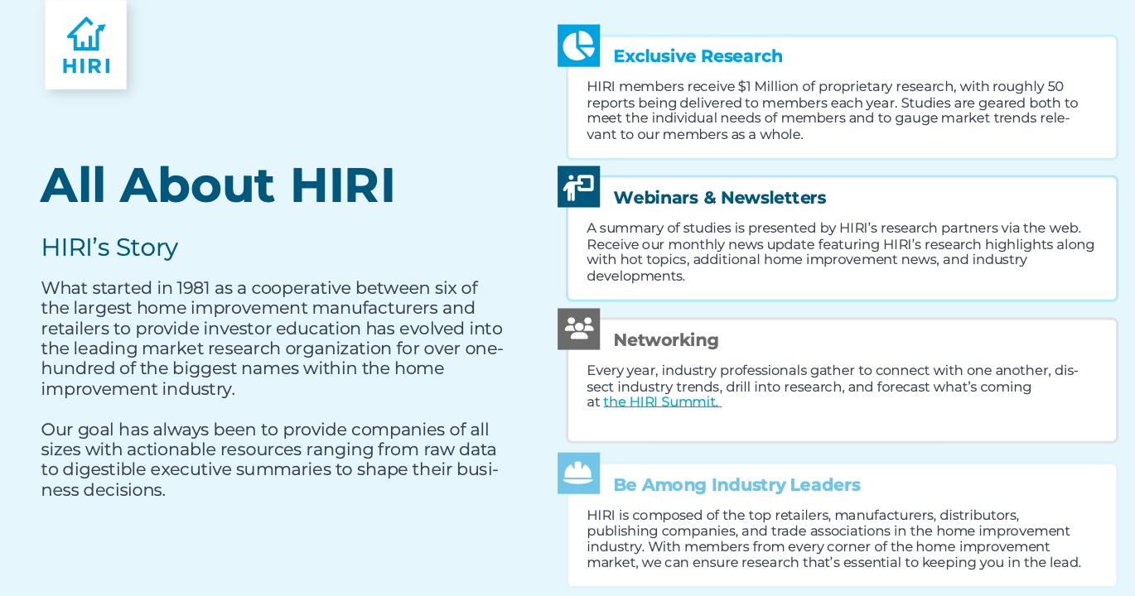
Who is HIRI?

Slide 3


SEPTEMBER 29 – 30 | MINNEAPOLIS, MN
Register Early for Next Year’s Event!
Notes:
Forecasts in 2025 revealed stronger 2024; revised down in Q2.

Slide 4

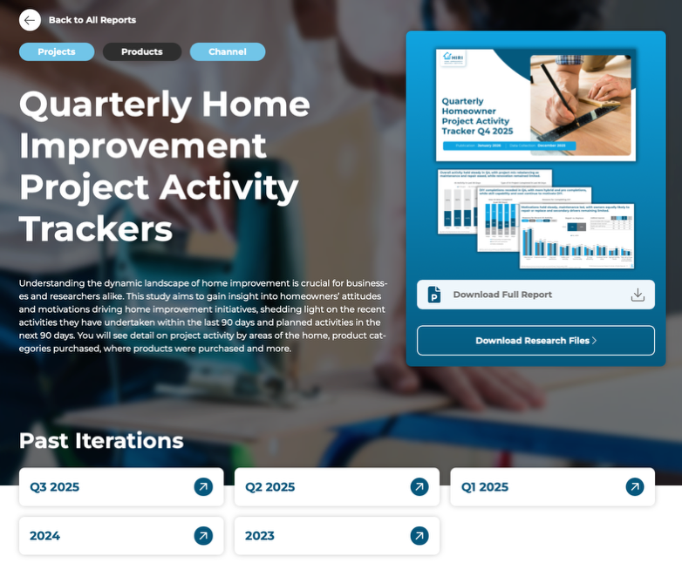
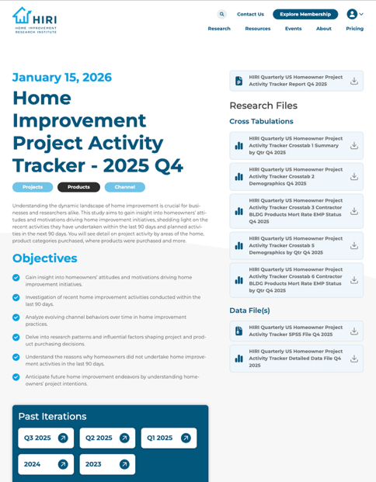
HIRI Research Organization
Notes:
Forecasts in 2025 revealed stronger 2024; revised down in Q2.

Slide 5
Spend Remains Elevated Despite Weak Turnover
Home improvement spending holds near record levels as repair and replacement anchor demand even in a subdued housing market.
BP Forecast (Billions of Dollars)
(2025-09 Forecast)
BP Growth by Customer Type
(2026-02 Preliminary Estimates)
Source: US Size of Home Improvement Forecast 2025-Q3

Slide 6
2025: Quick Wins and Replacement Outperform Large Remodels
DIY refresh and essential replacements remain resilient while discretionary big-ticket projects face pressure.
BP Category by 2025 Nominal and Real Growth Rates
Inflationary Growth
True Growth Leaders
Nominal Growth Rate
Contracting Categories
Inflation-Adjusted Growth Rate

Slide 7
2026: Needs-based repairs and structural replacements drive gains; discretionary remodels lag, and most categories grow via inflation.
BP Category by 2026 Nominal and Real Growth Rates
Inflation-Adjusted Growth Rate
Inflationary Growth
True Growth Leaders
Nominal Growth Rate
Contracting Categories
Source: HIRI US Size of Market Forecast 2026 Q1 (Preliminary Report)

Slide 8
Mobility Is Constrained. Remodeling Is Compensating.
Weak transaction volume is no longer dictating remodeling activity as deferred moves extend tenure and shift demand toward reinvestment.
First time buyer activity at historic lows
Home buying sentiment negative
Population growth slowing
Rates stabilizing but still restrictive
Bad Time to Buy
73%
Source: HIRI/TFG Analysis of NAR Data

Slide 9
Activity Has Stabilized at a High(er) Baseline
2025 showed steady project participation with modest growth, signaling normalization rather than retrenchment.
HI Activity in Last 90 Days
Type of HI Project Completed in Last 90 Days
Source: HIRI/TFG Quarterly Tracker 2025 Q4

Slide 10
Home improvement spending intentions held steady, positioned between protected necessities and flexible discretionary categories.
25Q4 Planned Household Spend (Next 12 Months)
Planned HI Spend (Next 12 Months)
Q15. How will your household spend change in the next 12 months compared to the last 12 months on the following?
(1-Spend much less, 3-About the same, 5=Spend much more)

Slide 11
Confidence Lags Financial Reality
Sentiment remains significantly below prior-year levels despite stable employment and moderating inflation.
Source: University of Michigan. Units & Frequency - Index 1966:Q1=100, Not Seasonally Adjusted & Monthly

Slide 12
Most concerns eased or held steady in Q4, though inflation reasserted itself, reinforcing a cautious but stable homeowner mindset.
Biggest Concerns Over Last 12 Months
Additional responses​ | ’25​ Q1​ | ‘25​ Q2​ | ‘25​ Q3​ | ‘25​ Q4
Environmental | 6% | 5% | 6% | 5%
Public health | 6% | 5% | 3% | 5%
Education | 3% | 5% | 4% | 4%
Being laid off | 2% | 2% | 3% | 4%
A housing crash | 4% | 2% | 1% | 4%
24Q4
25Q1
25Q2
25Q3
25Q4
Q62. What were your biggest concerns over the last 12 months? (Select up to 3) *Option added in 25Q3

Slide 13
Disposable Income is the Primary Growth Engine
Consumer sentiment has a shorter-term impact, whereas
disposable income is a better gauge for home improvement spend.
Metrics Indexed to Late-2019:
Top Predictors of BP Spend:
Quarter-on-quarter change in BP spend
5-quarter change in disposable income
1-quarter change in consumer sentiment
HI Avg Project Time
Total: 15 Months
Source: HIRI analysis
Notes:
Forecasts in 2025 revealed stronger 2024; revised down in Q2.

Slide 14
Income Growth Softened in 2025 but Is Improving
2025 marks weakest growth since 2022 but improves thereafter as households see income gains and savings near pre-pandemic norms.
Present Day
Annual percent change
Percent of disposable income
Source: HIRI Size of Home Improvement Product Market 2025-Q3
Notes:
Forecasts in 2025 revealed stronger 2024; revised down in Q2.

Slide 15
Higher Income Households Drive Disproportionate Spend
Upper-income homeowners account for the largest share of improvement spend, Growth strategies must prioritize segments with financial capacity.
Those Seeing Financial Improvement
Change in Financial Situation
2023-2024 HI Spend

Slide 16
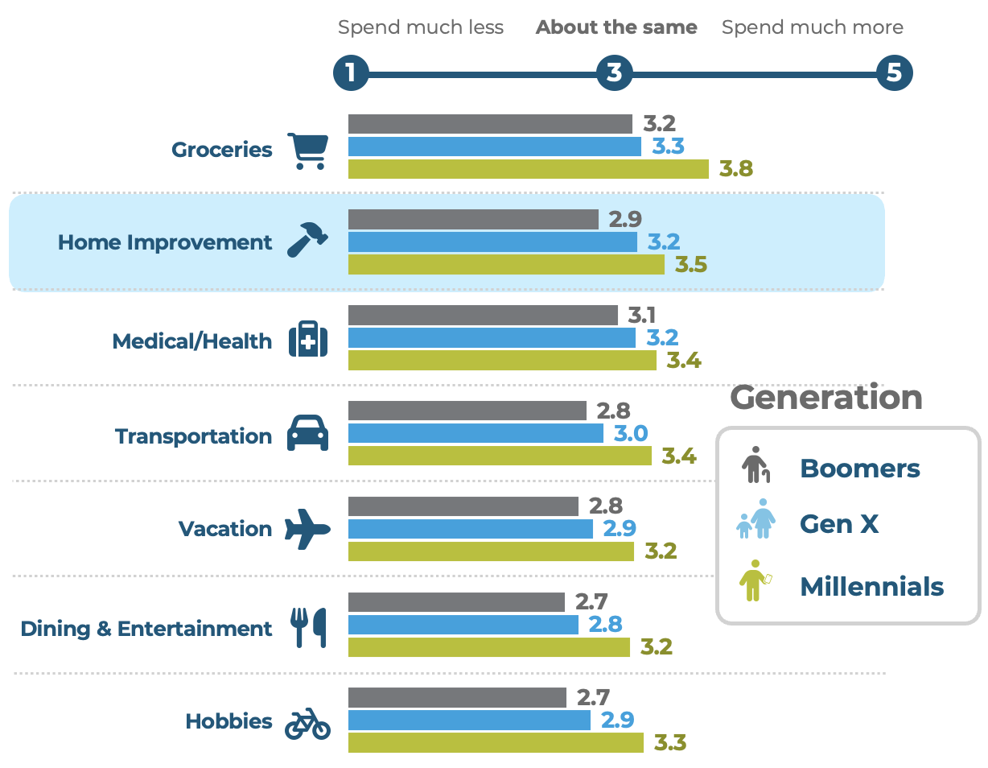
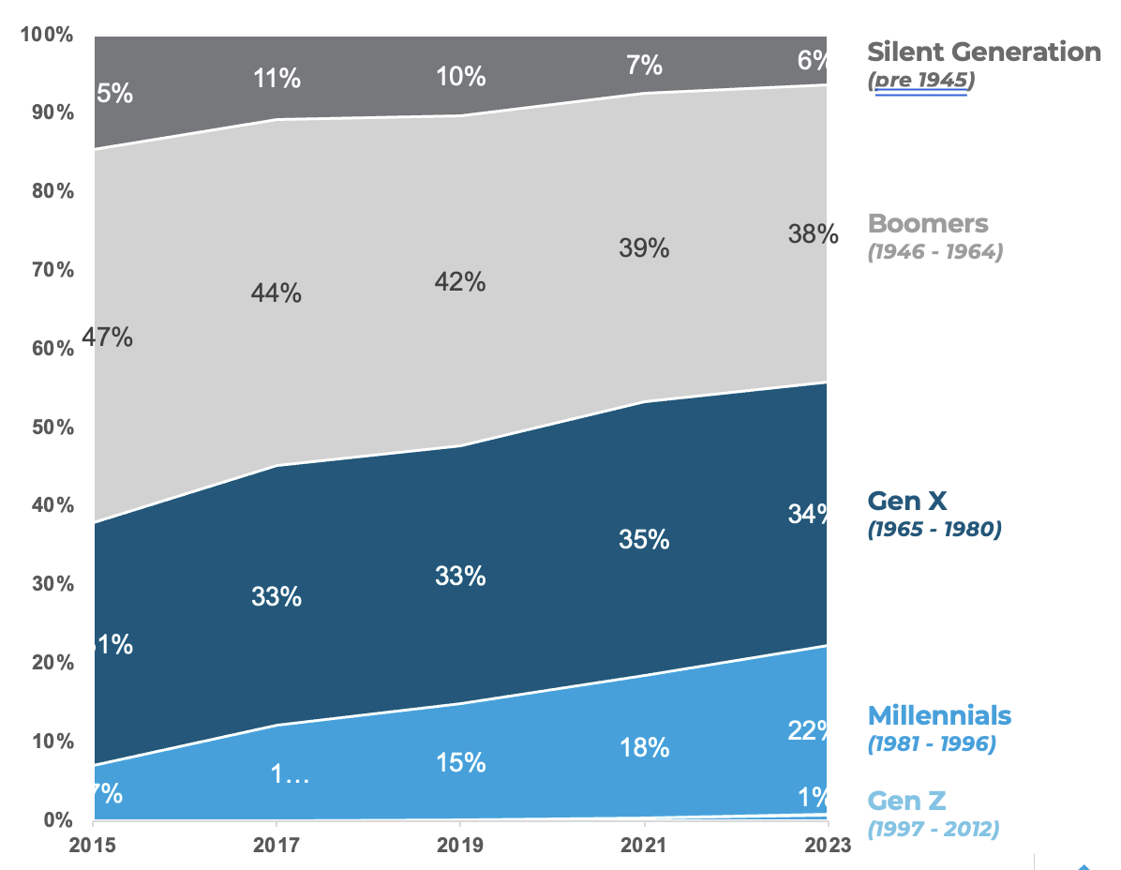
The Center of Spend Is Getting Younger
Millennials are increasing their share of building product spend while older cohorts gradually moderate.
Plan to Spend More
Generational BP Spend

Slide 17
Share of Home Improvement spend by generation
Over the last ten years, Boomers' share of remodel spend continues to dwindle as a larger share of Millennials become home-owners.
Silent Generation
(pre 1945)
Boomers
(1946 - 1964)
Gen X
(1965 - 1980)
Millennials
(1981 - 1996)
Gen Z
(1997 - 2012)
Source: HIRI/TFG analysis of AHS data
Notes:
Forecasts in 2025 revealed stronger 2024; revised down in Q2.

Slide 18
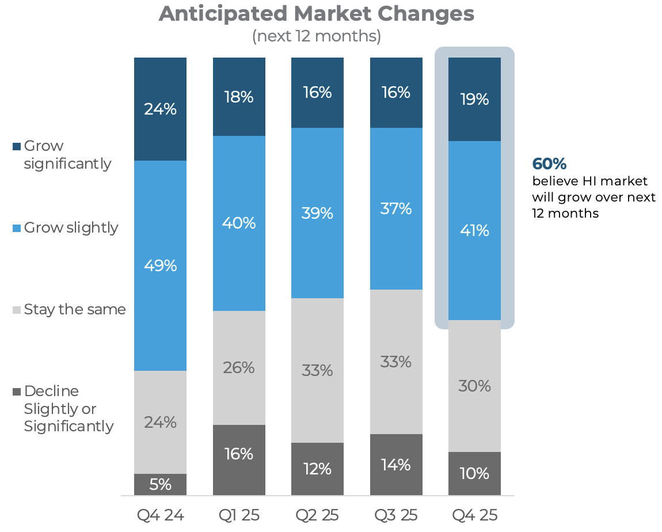
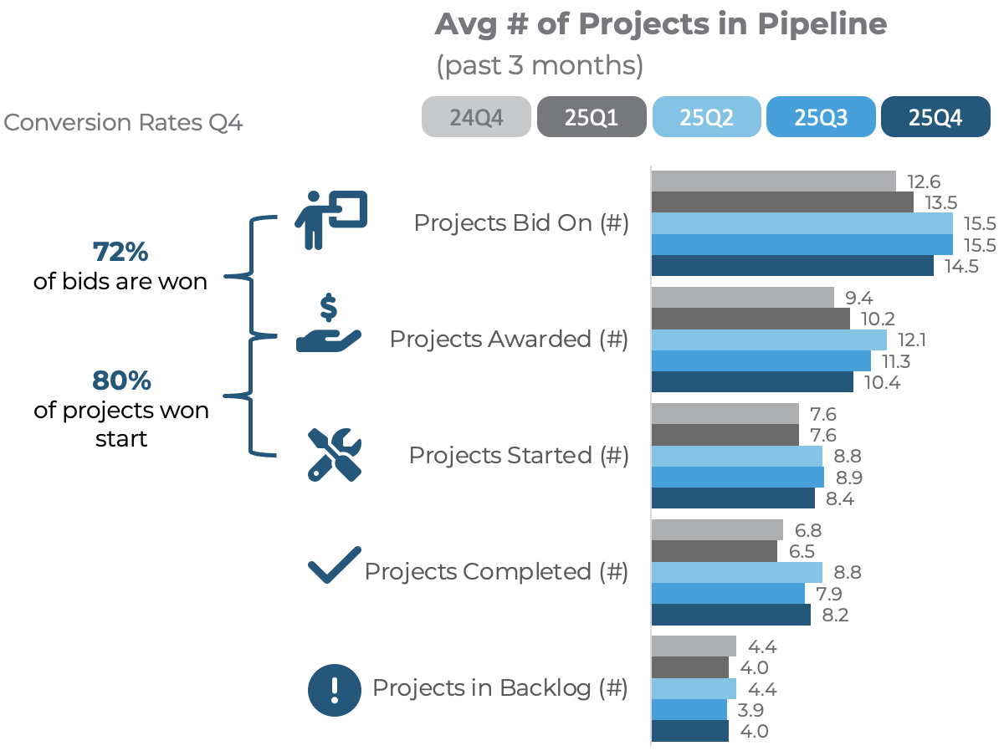
Pro Outlook Stable but Backlogs Suffer
Contractors report strong conversion rates and optimism, though backlog and scheduling volatility remain elevated.

Slide 19
Implications for Strategy in 2026
Normalization changes where and how growth is captured.
Design for a stay-driven homeowner, not a move-driven one.
Anchor growth to durable income strength, not fleeting confidence.
Compete where spend is concentrating, not where it is evaporating.
Win in essentials and right-sized projects, not oversized discretionary bets.
Enable the Pro to move faster, convert higher, and operate productively.

Slide 20





Future Webinar…

Slide 21
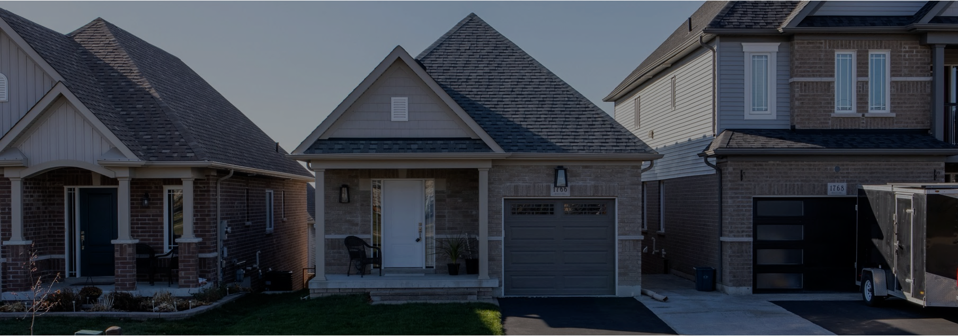

Thank You
Dave King
dking@hiri.org
801.669.0866
/daveking-ut
Schedule a Meeting

Slide 22
Recent Research Release Example

Slide 23

Made in America
Publication : November 2025
Data Collection: July 2025

Slide 24
Manufacturing country of origin matters, yet price, quality, and durability seem to dominate most home improvement decisions.
Important Factors in Choosing HI Products
Q12. When choosing home improvement products for a project (like tools, hardware, paint, etc.), which of the following factors are important to you? Select all that apply

Slide 25
♀♂
The U.S. overwhelmingly dominates manufacturing preference, with most homeowners including it among their top choices.
Four Types of Homeowners
Q18. Please select the following countries or regions that you would prefer to buy home improvement products from.?

Slide 26
Even with top ratings in all attributes, Chinese-made products still trail average rated American-made options in purchase preference.
Share of Preference (Scenario 5)
Recommendations to Increase Preference (China) | Top Ways to Gain Share
+21.04% | Online Reviews Mixed → Highly Rated
+7.58% | Price AVG → Low Price (25% Below AVG)
+7.31% | Product Quality Better → Best
+6.43% | Product Availability Moderate → Always (In Stock)
+6.38% | Product Support Standard → Premium Support
+7%
Improving a Chinese manufacturer’s online reputation, price, quality, availability, and support still doesn’t bring to parity American-Made advantage in share of preference.
 | United States | Canada | Other | Mexico | China | None
Online Reviews | Mixed Reviews | Mixed Reviews | Mixed Reviews | Mixed Reviews | Highly Rated | (Would not select any of presented options)
Price | AVG Price | AVG Price | AVG Price | AVG Price | 25% Below AVG
Product Quality | Better | Better | Better | Better | Best
Product Availability | Moderate | Moderate | Moderate | Moderate | Available (in stock)
Product Support | Standard | Standard | Standard | Standard | Premium
Q14 - Imagine that you are purchasing a building product for a home improvement project (e.g. plumbing fixtures, flooring, windows, doors, siding, roofing, etc.). As you are presented with different product options, please choose the one you would most likely purchase for your project. [CONJOINT ANALYSIS]

Slide 27



Segment Summaries
58%
29%
13%
Continental Preference
Skew older: 54% Boomers, 26% Gen X, 20% Millennial/Gen Z.
Gender: 54% female; 61% suburban, 22% rural, 17% urban.
Income: 48% earn < $80K, 32% $80–159K, 20% $160K+.
DIY: 47% novice, 33% intermediate, 8% advanced.
Purchase drivers: Price (80%), quality (68%), durability (58%).
Trade awareness: 60% somewhat familiar with tariffs; 25% highly.
Tariff fairness: 48% unfair, 23% fair; 41% see no impact on buying behavior.
Country preference: 93% U.S., 72% Canada, 29% Mexico, 29% Europe.
Political lean: 37% conservative, 34% moderate.
AVG Last 12 Mo HI Spend: $8,799 AVG Planned Next 12 Mo: $3,672
American Proud
Generational mix: 39% Boomers, 32% Gen X, 30% Millennial/Gen Z.
Gender: 58% male; 46% suburban, 27% rural, 27% urban.
Income: 42% < $80K, 34% $80–159K, 24% $160K+.
DIY: 30% novice, 40% intermediate, 22% advanced.
Purchase drivers: Price (68%), quality (67%), Made in America (57%).
Trade awareness: 70% highly familiar with tariffs.
Tariff fairness: 76% view tariffs as fair; 60% more likely to buy U.S. goods if prices rise.
Country preference: 96% U.S., 48% Canada, 23% Mexico, 23% Europe.
Political lean: 39% conservative, 35% moderate.
AVG Last 12 Mo HI Spend: $10,359 (Highest) AVG Planned Next 12 Mo: $9,011 (Highest)
Global Pragmatist
Skew younger: 43% Millennial/Gen Z, 30% Gen X, 27% Boomer.
Gender: 51% male; 54% suburban, 35% urban, 11% rural.
Income: 40% < $80K, 34% $80–159K, 26% $160K+.
DIY: 43% novice, 31% intermediate, 13% advanced.
Purchase drivers: Performance (48%), price (70%), quality (66%).
Trade awareness: 45% highly familiar with tariffs.
Tariff fairness: 52% unfair; 50% say tariffs raise bias toward imports.
Country preference: 100% China, 78% U.S., 55% Canada.
Political lean: 36% moderate, 32% liberal, 32% conservative.
AVG Last 12 Mo HI Spend: $5,937 AVG Planned : $6,205 (4.5% increase)

